Slide 1
Corporate Social Responsibility Project and Activities
(2026-27)

Slide 2
Five Pillars of Our CSR
APM Terminals
CSR
Education
Women and Skill Development
Health, Safety & Environment
Disaster & Relief Management
Socio Economic Development
2

Slide 3
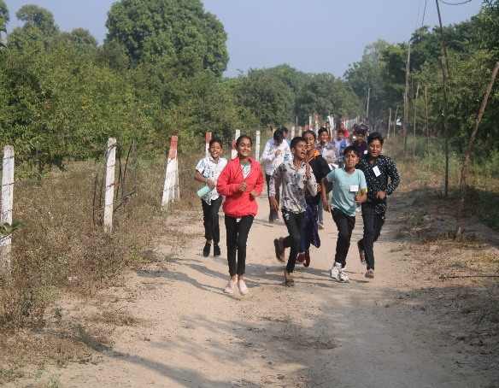
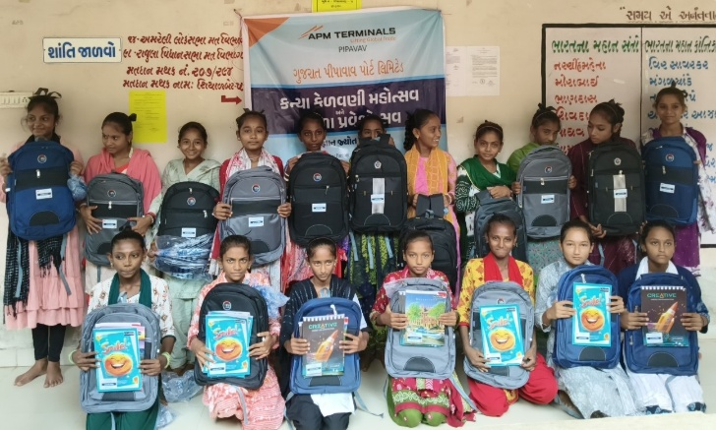
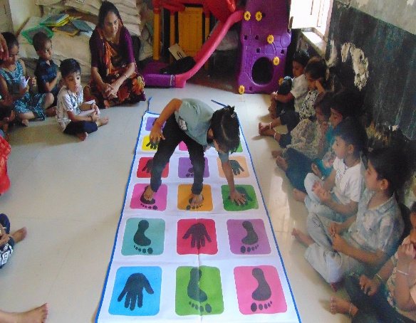
Gyan Jyot - Eradicating Poverty by Enhancing the Education Level and Behavioural Change
Spread: Rampara-2, Bherai, Kadiyali, Pipavav Dham, Shiyalbet, Padar, Devpara, Thavi & Diwlo.
Beneficiaries: 24,000 villagers and 4000 students.
Major Achievements till March 2026:
-Improvement in the Board Result is reported between 87.50% to 98.50%, Enrolment rate in Primary, Secondary and Higher Secondary is 100%, 95.50% and 94% respectively.
-Outdoor and Indoor Playground Development and library support in 28 Schools, Smart Classrooms in 10 Schools and 15 Balwadi Centers.
-Construction of School Sanitation Units and Baalwadi, Learning Resource Centre at Rampara, Divalo, Padar and Thavi, Computer Lab at Kasturba Balika Vidhyalaya, Rajula and Rampara High School, Children Home Amreli and School for Blind and Visually Challenged at Thordi etc.

Slide 4
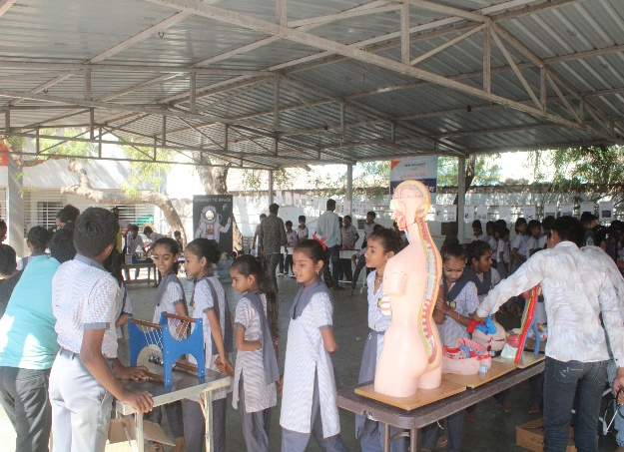
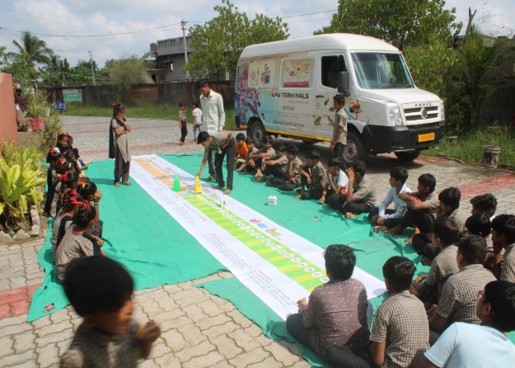
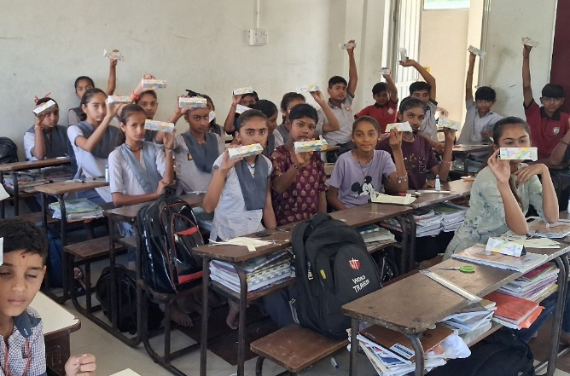
Spark - Mobile Science and Maths Lab
Spread: 23 villages surrounding port (Primary & High Schools of Bherai, Rampara-02, Shiyalbet, Chatdiya, Kadiyali, Ningala-02, Pipavav Dham, Bhachadar, Vad, Ucchaiya etc. )
Beneficiaries: Approx. 8000 students & Science and Maths Teachers belonging to Schools of 23 Villages.
Major Achievements till March 2026:
-Significant improvement in the performance of science and maths subjects of students.
-Annual Science, Maths and Environment Exhibition, Sky Watching, Winter and Summer Camps.
-Improvement in the motivation for learning science, maths and environment subjects is
observed.

Slide 5
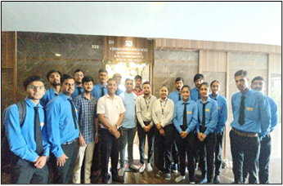
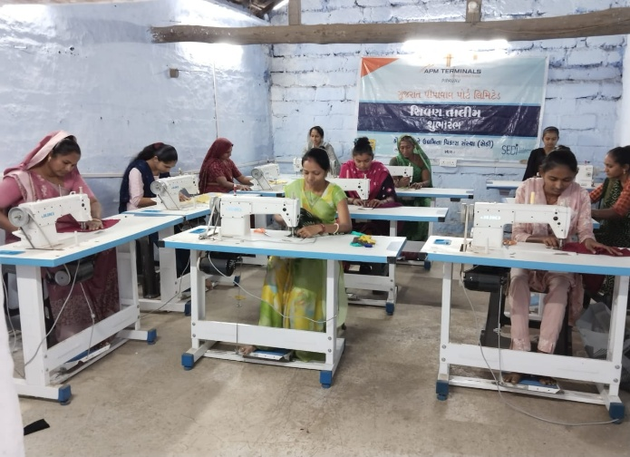
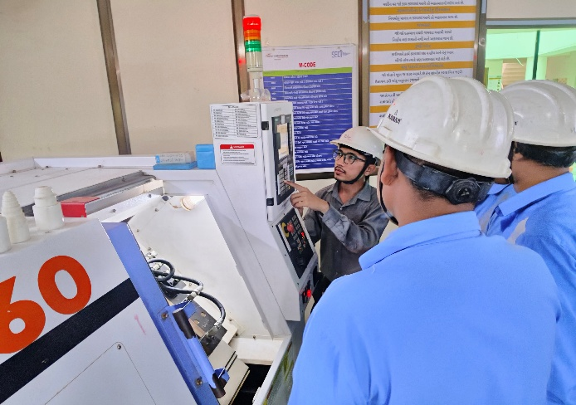
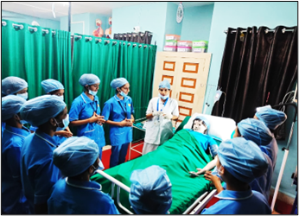
Saksham - Vocational Skill and Entrepreneurship Development at Rajula and
Virtual Reality Centre of Excellence Lab and Leadership Training at Gujarat Maritime University, Skill Development Centre at Uvarsad, Gandhinagar
Spread: Above 400 villages of Amreli and surrounding districts, Students of Gujarat Maritime University
Beneficiaries: Youths of project villages & One Main Institute at Rajula & Two Sub Centres at Smt. Hiralaxmi Bhaidas Sanghavi Mahila Arts & Commerce College, Rajula), yearly around 200 students of Gujarat Maritime University and Women of Uvarsad, Gandhinagar
Major Achievements till 31st March 2026:
-Skilled above 4000 youths in the Nursing, Electrical, Computer Numeric Control, Data Entry Operator, Sewing Machine Operator Trades etc ; Placement rate 81%, salary range 10000 pm to 20000 pm.
-Above 500 trained Youths are self employed.
-18 (M – 15; F – 3) physically challenged youths are trained and placed.

Slide 6
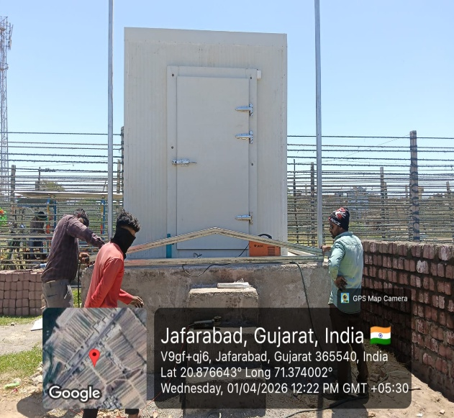
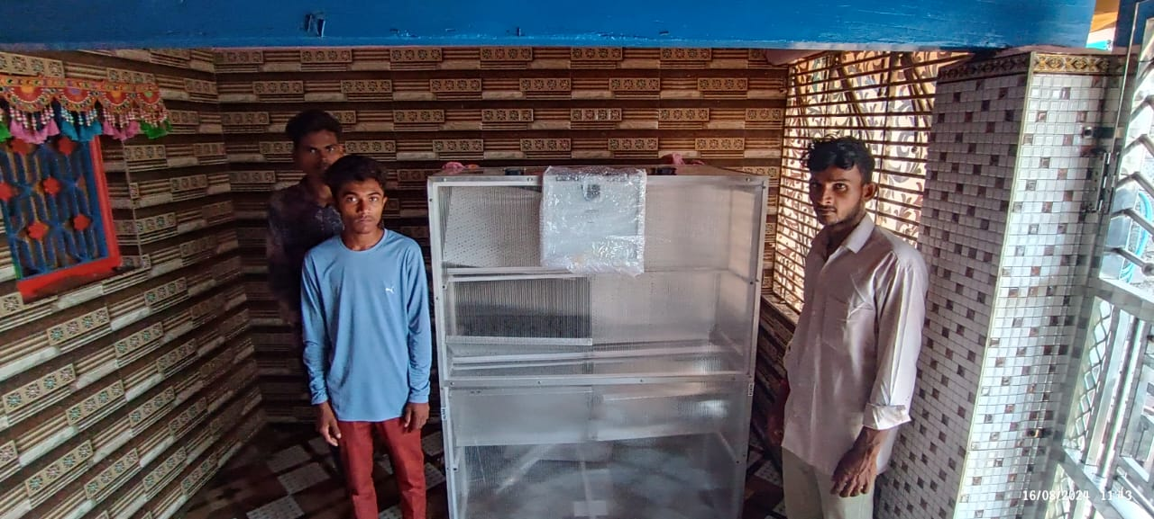
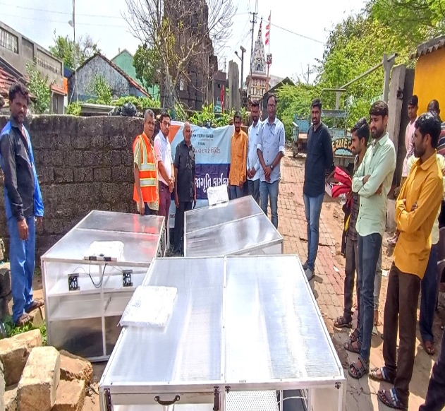
Sagar Mitra - Fisheries as a Livelihood
Spread: Shiyalbet, Divlo, Thavi and Jafrabad
Beneficiaries: 400 fishermen and women
Major Achievements till March 2026: Facilitated 827 first aid boxes, 227 ice boxes, 244 taalpatri, 256 pairs of hand gloves, 230 units of solar boat lights, 30 small ice box, 101 fishing net, 30 gum boots, 44 pagadiya kits, 211 units of domestic solar lights, 337 modular crates, 50 units of boat GPS distribution , 8 units of solar fish dryers, mini cold storage at Jafrabad etc.
-Sagarmitra Fisheries Producer Company formed for the sustainability of the project with more than 600 share holders.

Slide 7
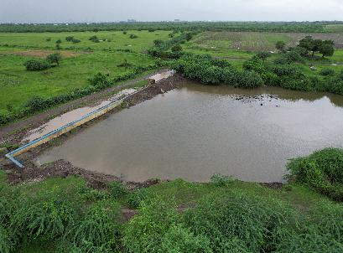
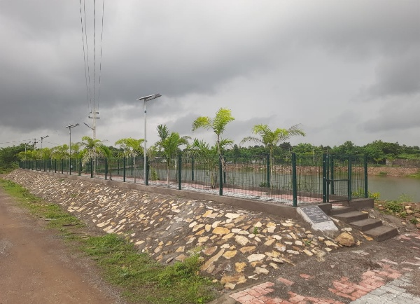
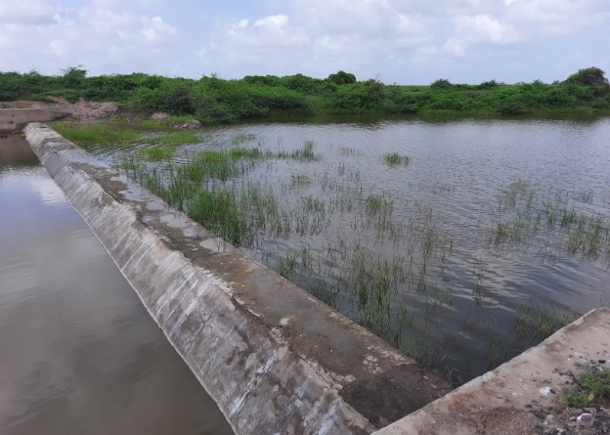
Jal Sanchya - Deepening and desilting of water bodies, Construction of Check Dams, Plantation Drive, Beach Cleaning etc.
Spread: Rampara, Bherai, Kubhariya, Vad, Uchaaiya, Bhachadar, Chatadiya, Ningala, Devpara, Divlo, Padar, Thavi, Kadiyali, Shiyalbet & Kotadi.
Beneficiary : Above 10000 house holds
Major Achievements till March 2026: Constructed 27 check dams, 101 RRWHS, 2 protection walls, 02 protection bund, 01 lift irrigation, around 2 lakh plantation, 2 community forestation, deepening of 23 water bodies, 208 well recharges, 18 well strengthening, 36 recharge pits, 210 units of vermiwash, 385 units of organic manure, 12 farm ponds, more than 3000 sanitation units etc. Yearly kitchen garden support to more than 300 poor households etc.
-Significant decrease in the TDS level of water in the project villages (from around 1536.4 ppm to 926.86 ppm) and significant increase in the level of ground water in the project villages (from around 25.46 m to 14 m)

Slide 8
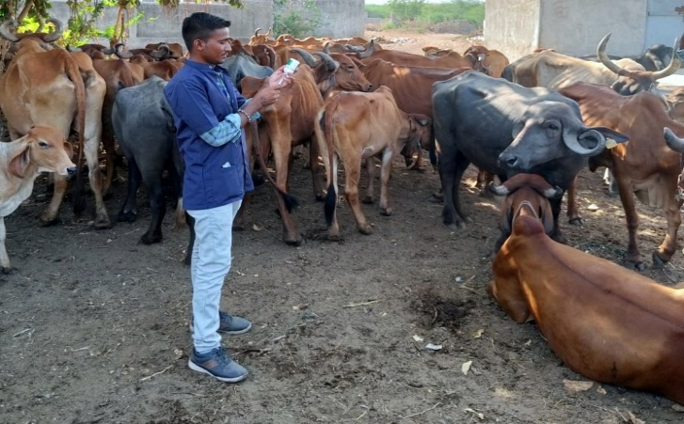
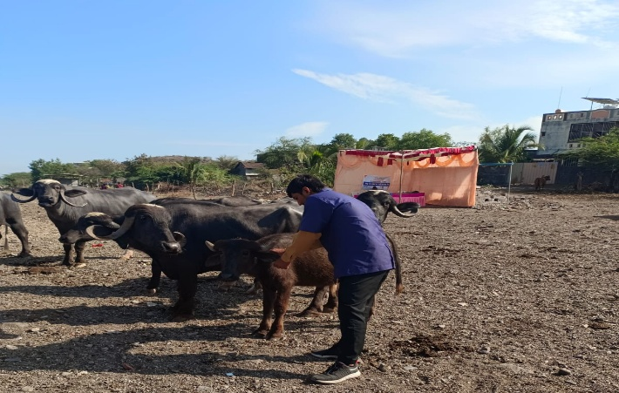
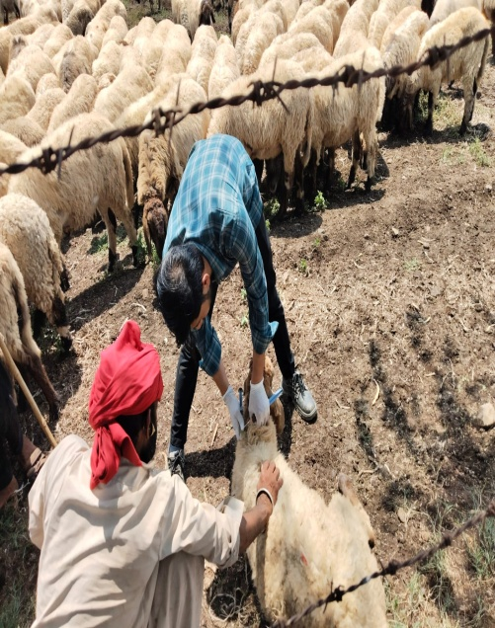
Pashuuday - Sustainable Livelihood through Integrated Livestock Development
Spread:45 villages (Shiyalbet, Rampara-02, Bherai, Kadiyali, Pipavavdham, Chhatadiya, Jolapar, Vadli, Ningala 1, Hindorana, Kotadi, Navi Barpatoli, Juni Barpatoli, Katar, Zapodar, Dhuliya Agariya, Nava Agariya, Mota Agariya, Mandardi Navi-Juni, Khakhbai, Vavdi, Vavera, Dhareshwar, Dipadiya, Nani kherali, Charodiya, Zanjarada, Barbtana, Khari, Bhakshi, Kherali Moti, Babariyadhar, Meriyana, Rajparda, Devka, Kumbhariya, Hadmatiya, Untiya, Ganjavadar, Kundaliyala, Mota Riganiyala, Khambhaliya, Doliya, Chhapari, Nana Ringaniyala,etc.)
Beneficiaries: More than 50000 live stocks and 5300 livestock owners.
Major Achievements till March 2026:
Average more than 500 female calves are born yearly,
Treatment of above 50000 live stocks through mobile vet clinic and health camps, vaccination of more than 01 lakh small animals.
4266 female calves born through artificial insemination
Pashuuday Charitable Trust is constituted for the sustainability of the project.

Slide 9
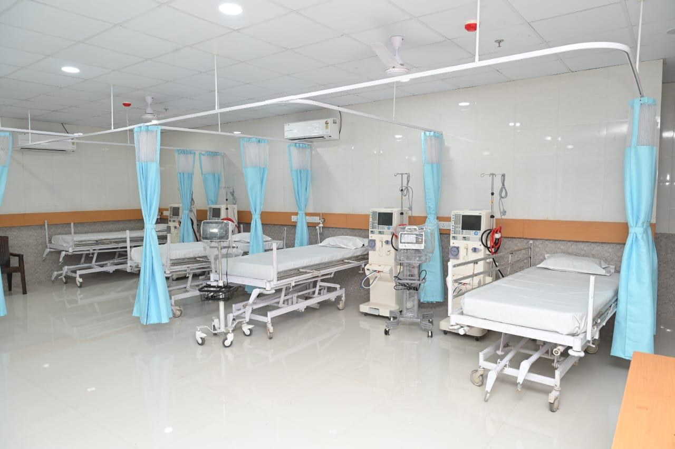
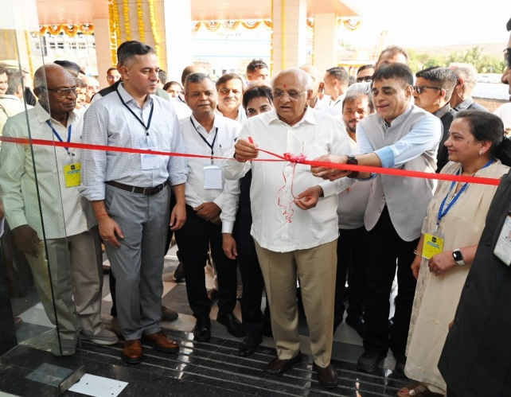
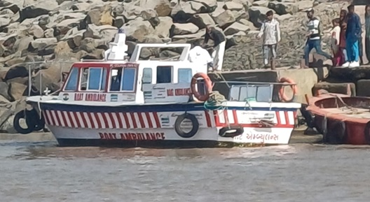
Raksha - Medical & Ambulance Support to Villagers
Inauguration of Sanjivani Emergency Care Center by Hon. Chief Minister of Gujarat
Mobile Health Unit, 24 x 7 Advance Life Support Ambulance, Boat Ambulance for Shiyalbet, Medical Support to Villagers at Port Dispensary
Spread: Bherai, Ramapara, Shiyalbet, Thavi, Devapara, Padar & Divalo, Truckers and Migrant Workers.
Beneficiaries: Above 2000 villagers every month
Major Achievements till March 2026: Monthly emergency medical support to more than 35 villagers and OPD treatment of more than 2500 villagers.
Established 12 bed high quality trauma centre at Mahatma Gandhi Arogya Kendra, Rajula

Slide 10
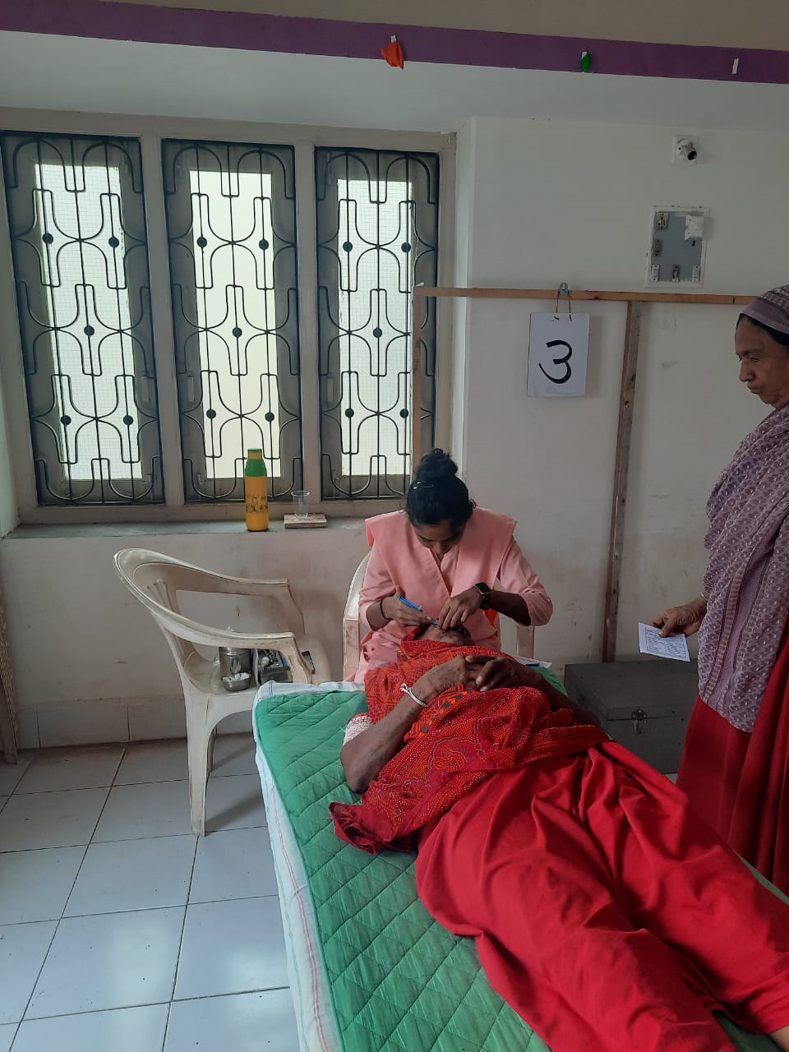
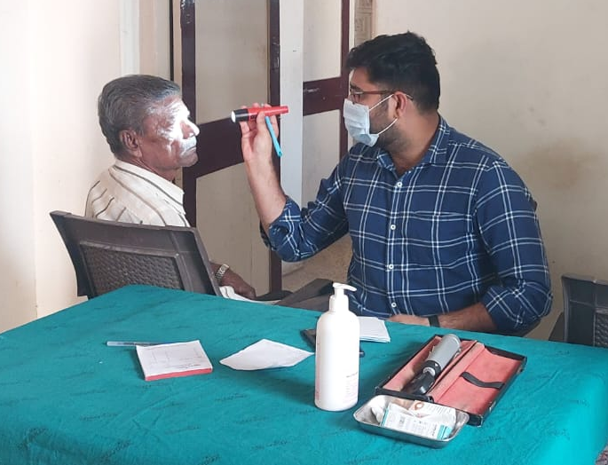
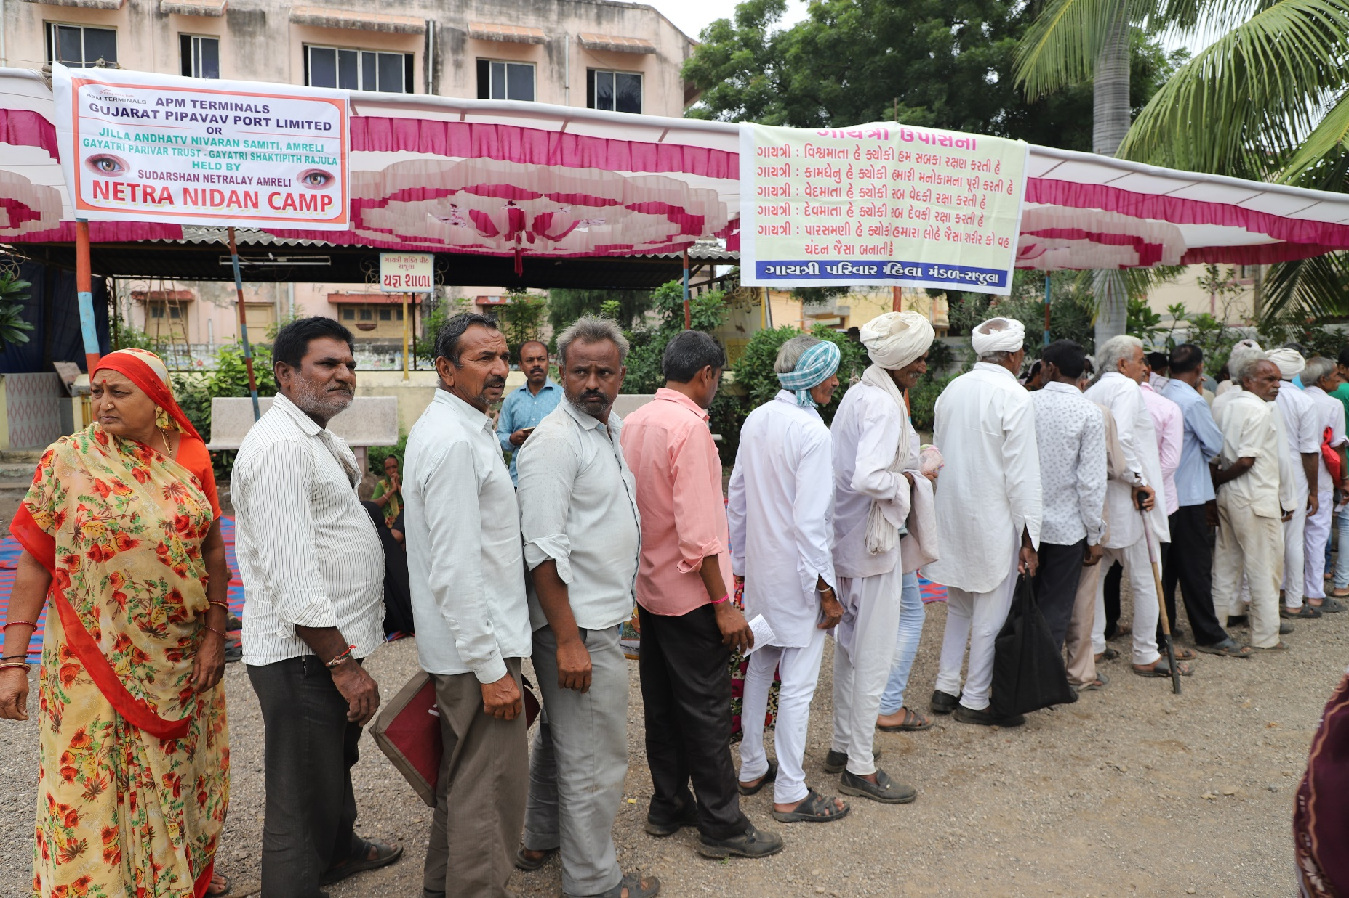
Roshani – Bi Monthly Eye Check-up Camp at Rajula and Surgery at Sudarshan Netralaya, Amreli
Spread: Above 80 villages of Rajula, Jafrabad, Khambha Talukas of Amreli District.
Beneficiaries: Above 200 persons per camp
Major Achievements till 31st March 2026: Treatment of more than 12000 villagers through OPD for eye related diseases and corrective glasses and more than 2697 cataract surgeries at Sudarshan Netralaya, Amreli

Slide 11
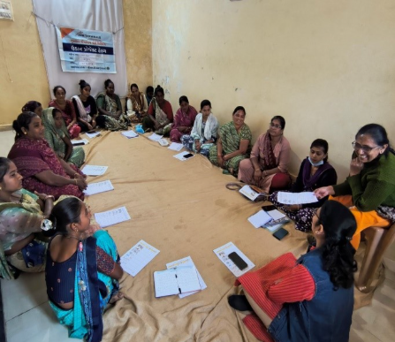
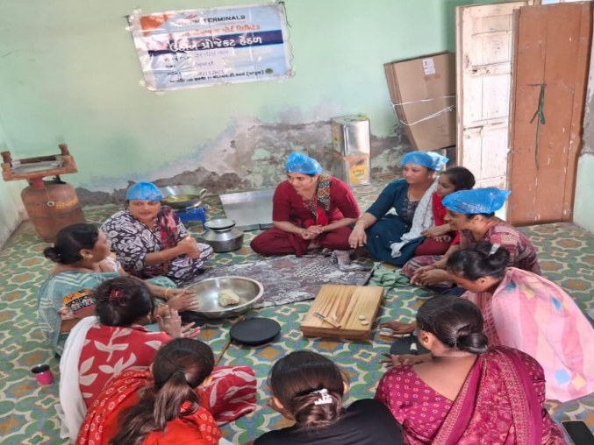
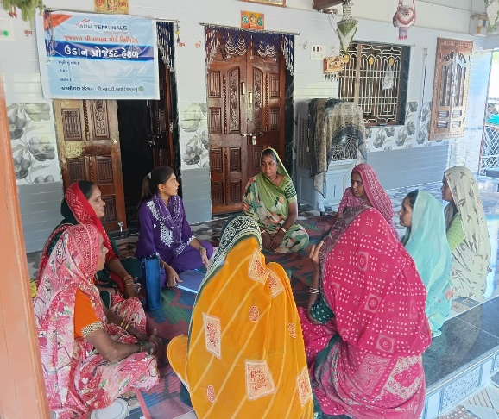
Udaan - Women Empowerment through Self-help Groups
Spread: Rampara-2, Bherai, Devpara, Charodiya, Mandardi, Ningala, Vavera, Kadiyali, Shiyalbet & Chatadiya, Dungar etc.
Beneficiaries: We have 51 women self-help groups consisting of 569 poor women. Established Utkantha Mahila Producer Company with 435 members.
Major Achievements till March 2026: Above 100 women of self-help groups have started business related to livestock, floor cleaner, plant nursery, mobile canteen, snacks & pickle making, organic manure and Khakhra etc. A women specific diamond polishing and cutting unit is established.

Slide 12
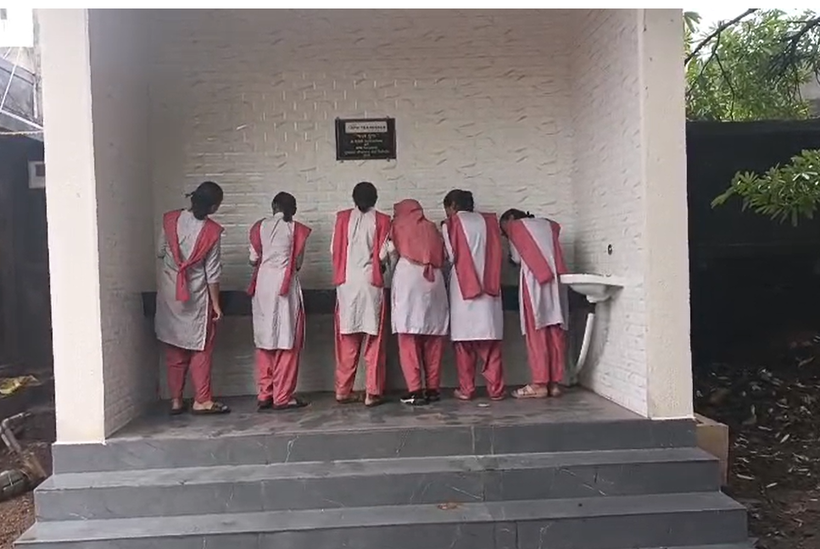
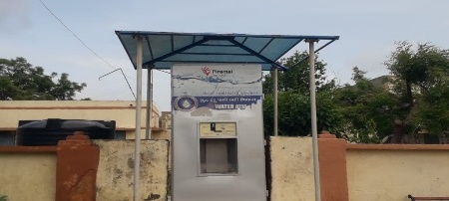
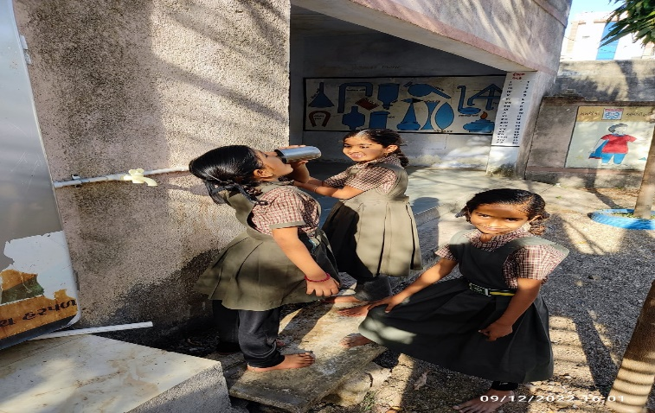
Clean and Safe Drinking Water
Spread: Schools of Jolapur, Ningala, Chhatadiya, Hadmatiya, Kadiyali, Sanghavi Girls School, Kumar Shala, Rajula etc.
Beneficiaries: Above 20000 human population and student of Schools of the respective villages.
Major Achievements: 12 water vending machines are handed over to the villages and are being used by school students and villagers.

Slide 13
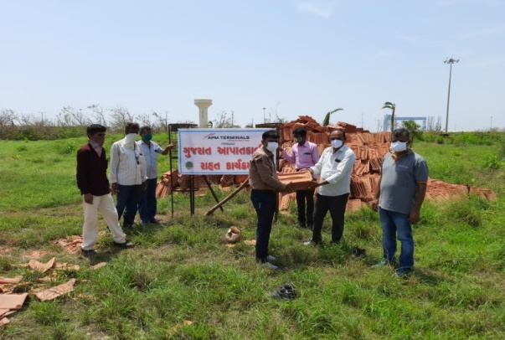
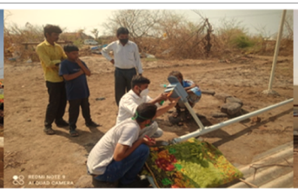
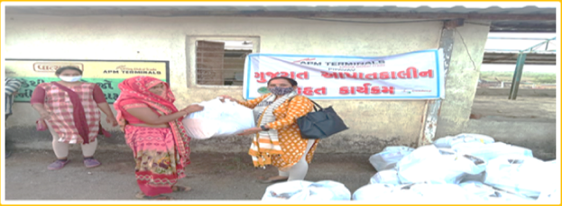
Disaster Relief and Rehabilitation Work
Spread: Rampara, Bherai, Shiyalbet and other villages of Amreli District Post Cyclone Rehabilitation and Covid Prevention
Beneficiaries: More than 15000 Poor and Marginal Families
Major Achievements till 31st March 2026: Supported district administration with 40 Oxygen Concentrators, more than 500 covid vaccination dose, 25 oxygen cylinders, distribution of more than 2 lakh masks in the surrounding villages and medical supplies like thermal scanners, hand gloves, sanitizers etc, 2 desk tops to local authorities, installation of 18 CCTV cameras in the surrounding villages
Distribution of more than 10 trucks of roofing materials, utensils, ration kits, installation of solar powered mobile chargers, solar domestic lights etc, support to subdivisional magistrate office with two desktops for disaster mitigation and related trainings.
Restoration of village side boat landing point of Shiyalbet, 412 units of streetlight at Bherai, Rampara and 135 units of solar street lights, restoration of school shed at Divalo etc.

Slide 14
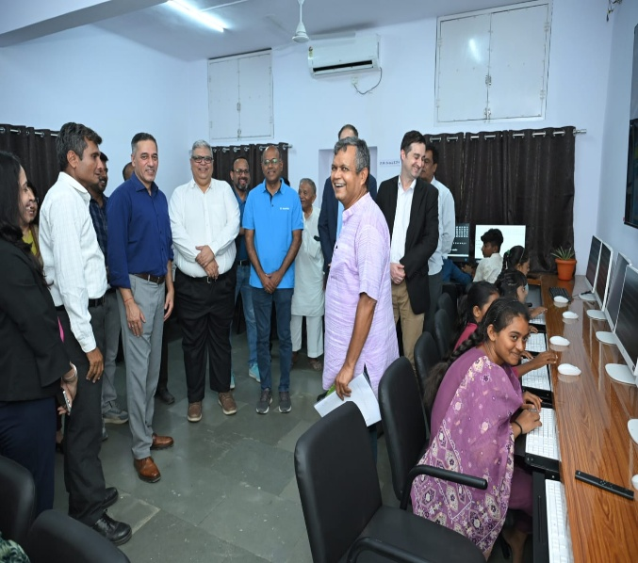
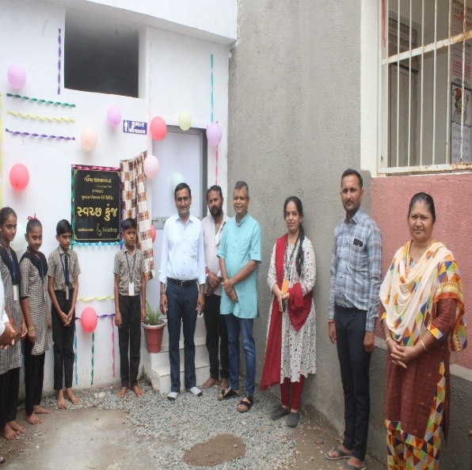
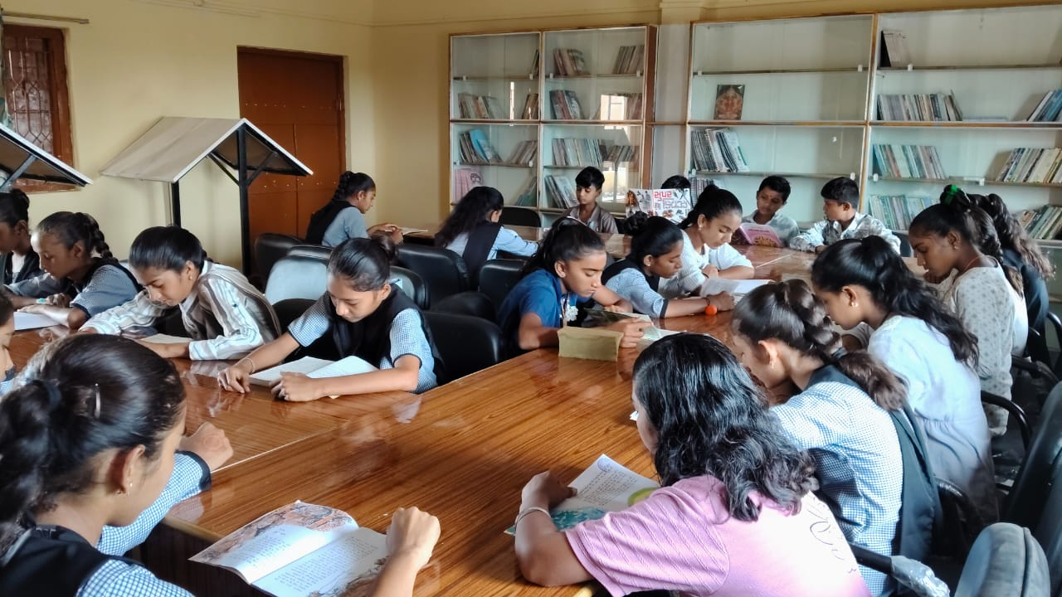
Other Activities (Partial)
-Construction of Sanitation Block for Girls, Library Support, Play Ground Development, RO Water Filter and Water Cooler in Schools and Children Home Amreli
-Sports promotion in the villages surrounding port.
-Science and Maths Lab at School & educational support for Blind and Visually Challenged Children, Amreli, Educational Support to the School for Deaf and Dumb Students, Amreli
-Mangroves Plantation and Bio Diversity Conservation

Slide 15
Thank you!

